Slide 1
Welcome to
HY5419 Digital History
Seminar 3: Historians’ role in creating and curating data
25 August 2025
Dr Matthias Wong
matthias.wong@nus.edu.sg | AS1/05-48

Slide 2
Roadmap for Today
Your thoughts and questions
Decision on class topics order
DH as a trading zone
BREAK
‘Open data’ – issues?
Historians’ ethical responsibilities
Concluding + Exit Questions

Slide 3
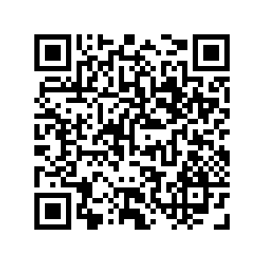
Your thoughts and feedback
‘I find myself struggling with the process of historical methods a little bit daunting.’
Digital history is best understood in comparison with ‘traditional’ ways of doing history.
Do let me know if you need help with historiography, philosophy of history, historical method etc
PollEv.com​/mw031

Slide 4
Your thoughts and feedback
‘Some examples: (1) Loh Kah Seng et al. Theatres of Memory - which used a Facebook group to post archives (photos, mostly) and collect Facebook comments, which were then used as quasi-oral interviews; (2) NewspaperSG - where the whole page is digitized as a separate "click" from individual articles, so it's very easy to forget about the whole-page view, even though you have a digitized searchable image of the article’
Lots of innovation happening in with digital means
But also lots of trade-offs – why might the digitized image be kept separately from the text?
What are you looking for, what are you willing to trade?
PollEv.com​/mw031

Slide 5
Your thoughts and feedback
‘In the discussion about dirty data, I'm not quite clear on whether digital historians should strive to include as much data as possible when creating a database, or if they should first conduct personal screening. Will this personalized screening affect the validity of the database?’
Screening happens all the time – we do the same with a ‘traditional’ history paper
Depends also on your starting point: what information do the sources provide (text/numbers but also colour?), what information does the historian need to note and include (date of access?)
Impossible to anticipate all future users of a database – hence we should always document our choices and decisions, so subsequent users know whether a database is ‘valid’ (usable) for them
PollEv.com​/mw031

Slide 6
Your thoughts and feedback
‘How do digital historians/digitization works survive or even continue...It was mentioned how academia rewards some works over others and how some digital historians branch out into museums, archives or private firms. How does that impact who can have access to these digital works/histories? How are digitization efforts not seen as something that will be impactful towards future research in academia?’
Change can be slow – like all industries, leaders/managers in academia are tied to ‘traditional’ metrics
But some regional variations, some driven by politics and/or
vision – UK uses ‘impact’ metric
PollEv.com​/mw031

Slide 7
Your thoughts and feedback
‘How to navigate the ethical responsibility as a public historian/ archivist to increase access and the institutional expectation?’
An important theme of this week’s readings!
Usually decided partly by funding, access to resources
Individual scholars can set an example, subfields can set standards e.g. providing honorariums for community speakers, costing for childcare
Why are we in the academy? What drives us?
PollEv.com​/mw031

Slide 8
Your final project
For your digital history project, please confirm with me your choice of topic, approach and data by Wednesday @ 1800.
So we have time to amend and revise if necessary.
PollEv.com​/mw031

Slide 9
Today’s class objectives
DH and interdisciplinary – theoretical and practical considerations
Research practices and ethics – our obligations
Designing a better historical research project
PollEv.com​/mw031

Slide 10
Decisions!
What topics did you want to look at first (n.b. we are missing one week because of PH)
Text analysis (counting, sentiment analysis, concordance and associations)
Spatial analysis (deriving information from historical maps)
Machine learning (auto-transcriptions, object/entity-recognition)
Citizen science/crowdsourced research and Quantitative/relational (network analysis)
Visualising data (ethical re-presentation and figures for your research)
Scrolly-telling narratives (presenting a variety of information/media
for wider audience)
PollEv.com​/mw031

Slide 11
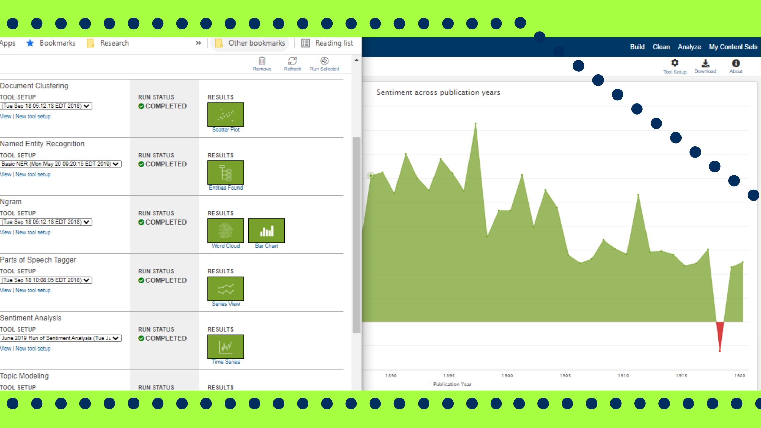
Text analysis
Tool: Gale Digital Scholarship Lab
Counting, concordance etc with NUS subscribed datasets
Analysis and visualization – look out for prep instructions before class
PollEv.com​/mw031
Notes:
https://www.cdcs.ed.ac.uk/events/gale-digital-scholar-lab-workshop

Slide 12
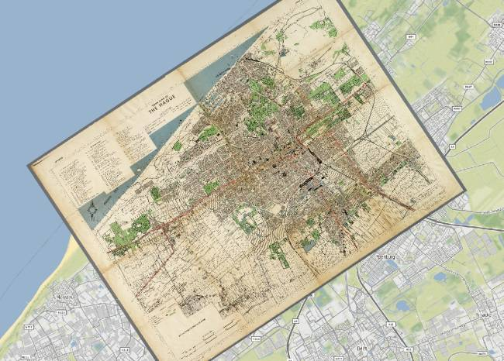
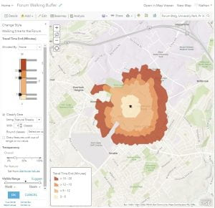
Spatial analysis
Creating data from digitized maps
Using data to aid research, create visualization(s)
PollEv.com​/mw031
Notes:
https://kokoalberti.com/articles/georeferencing-and-digitizing-old-maps-with-gdal/
https://blogs.loc.gov/maps/2021/01/georeferencing-moving-analog-maps-into-modern-day-gis/
https://sites.psu.edu/mapsgislib/2024/04/18/buffer-and-centroid-training-review/

Slide 13
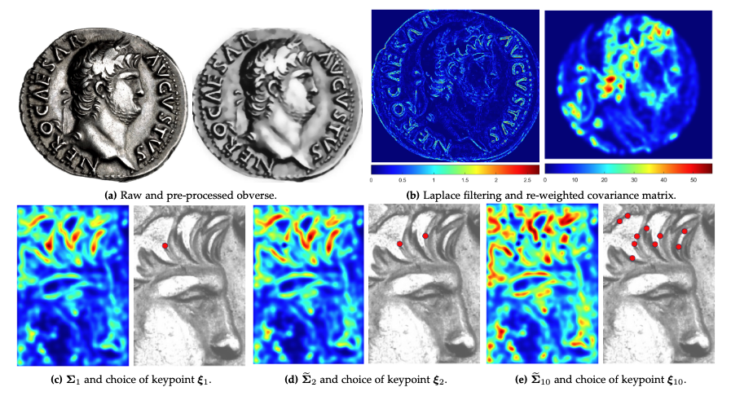
Machine learning & Citizen science
Using ML algorithms to analyse large datasets, and incorporating citizen science methods to assist with data creation
A/P Mayer on ancient numismatics (Roman coins) and using statistical methods
Notes:
https://arxiv.org/abs/2112.00290v1 v

Slide 14
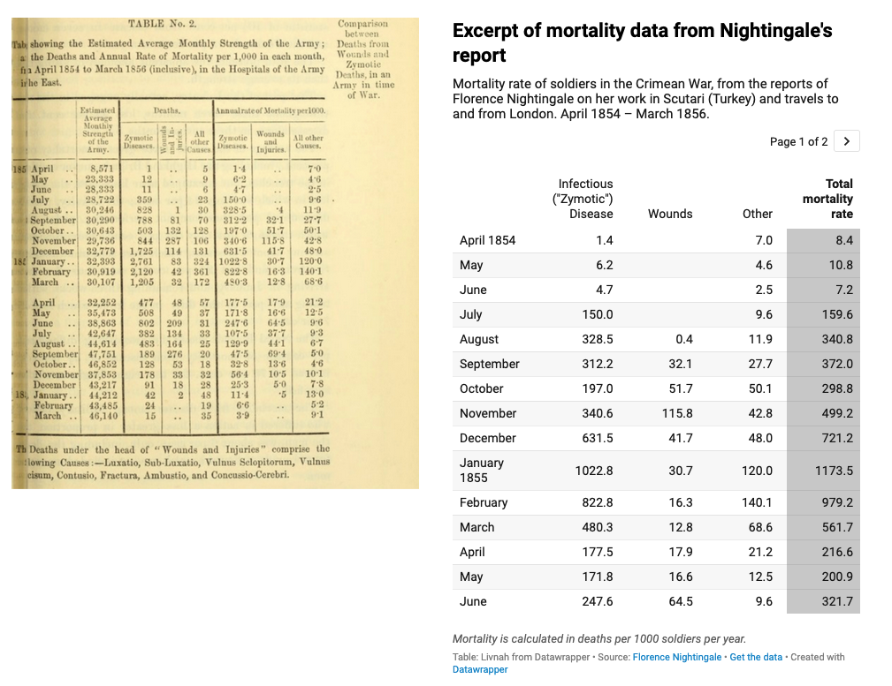
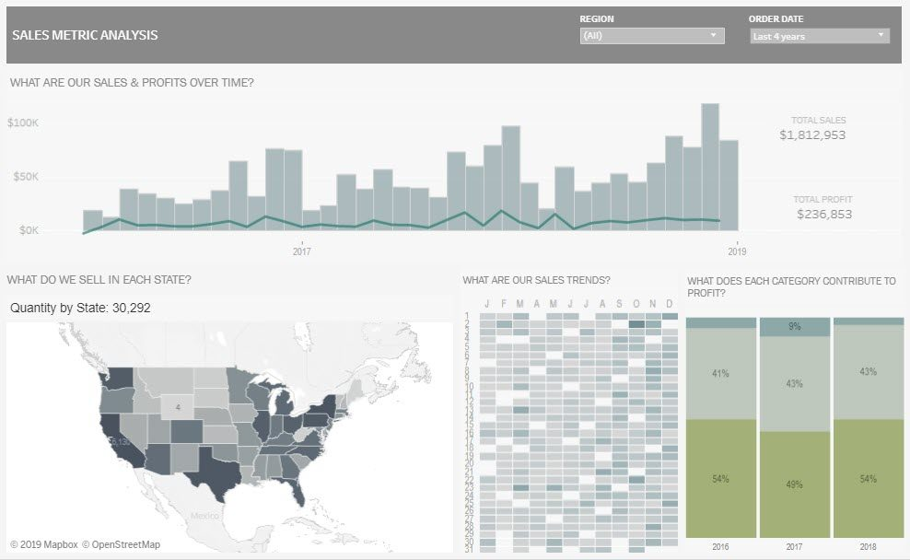
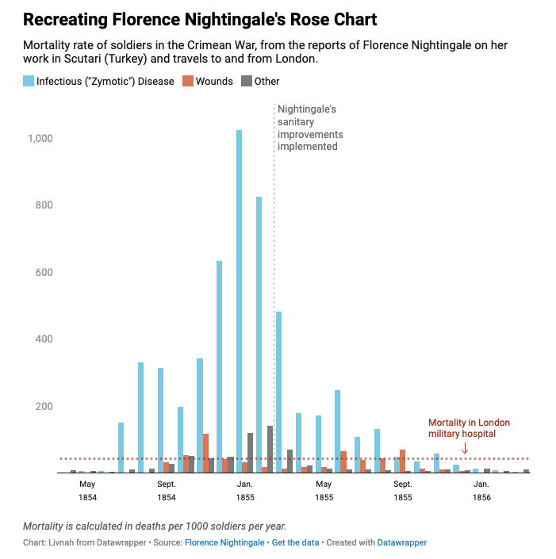
Visualising data
Tools: Tableau and Datawrapper
Notes:
https://blog.datawrapper.de/recreating-nightingale-rose-chart/

Slide 15
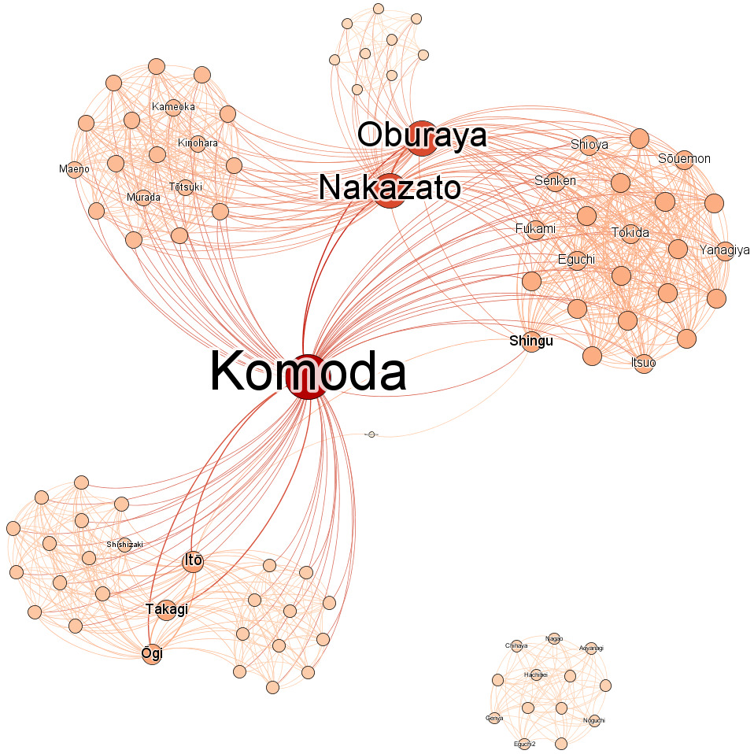
Network analysis
Analysing links between people to find the central players
Also where and how networks are connected.
Tool: Gephi
PollEv.com​/mw031
Notes:
https://culturalanalytics.org/article/68188-how-network-analysis-uncovers-international-networks-of-smuggling-history-criminals-in-nagasaki-japan-circa-1667

Slide 16
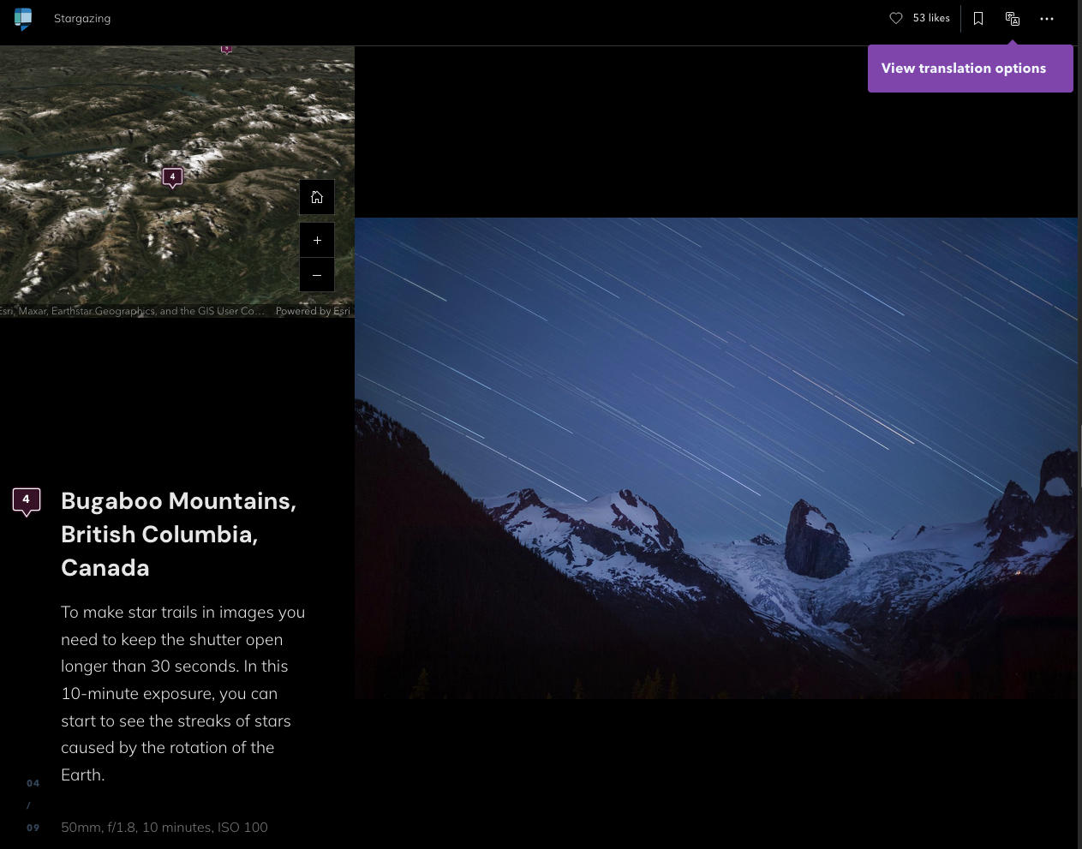
Scrolley-telling
The basics of sequential presentation
Multi-modal (text, image, spatial etc)
Tool: StoryMaps
https://storymaps.com/stories/3e4537588b4747e896342968032d0094
Notes:
v

Slide 17
Focus Questions
What are our ethical responsibilities as digital historians?
How can digital history do good in society?
PollEv.com​/mw031

Slide 18
DH and multi- / inter- / trans-disciplinary
If our goal as historians is to understand the past…
What other methods do you use/borrow that is not ‘historical’?
PollEv.com​/mw031

Slide 19
DH and multi- / inter- / trans-disciplinary
Material analysis from archeology
Biological anthropology using chemical methods
Computer programmes designed for other purposes
PollEv.com​/mw031

Slide 20
DH and trading zones
It is true that there is information asymmetry, maybe even disciplinary ‘violence’
Historians not understanding enough about comp-sci methodology to negotiate a tool that works properly.
But even if you know enough, still a matter of getting agreement and navigating internal politics/constraints…
PollEv.com​/mw031

Slide 21
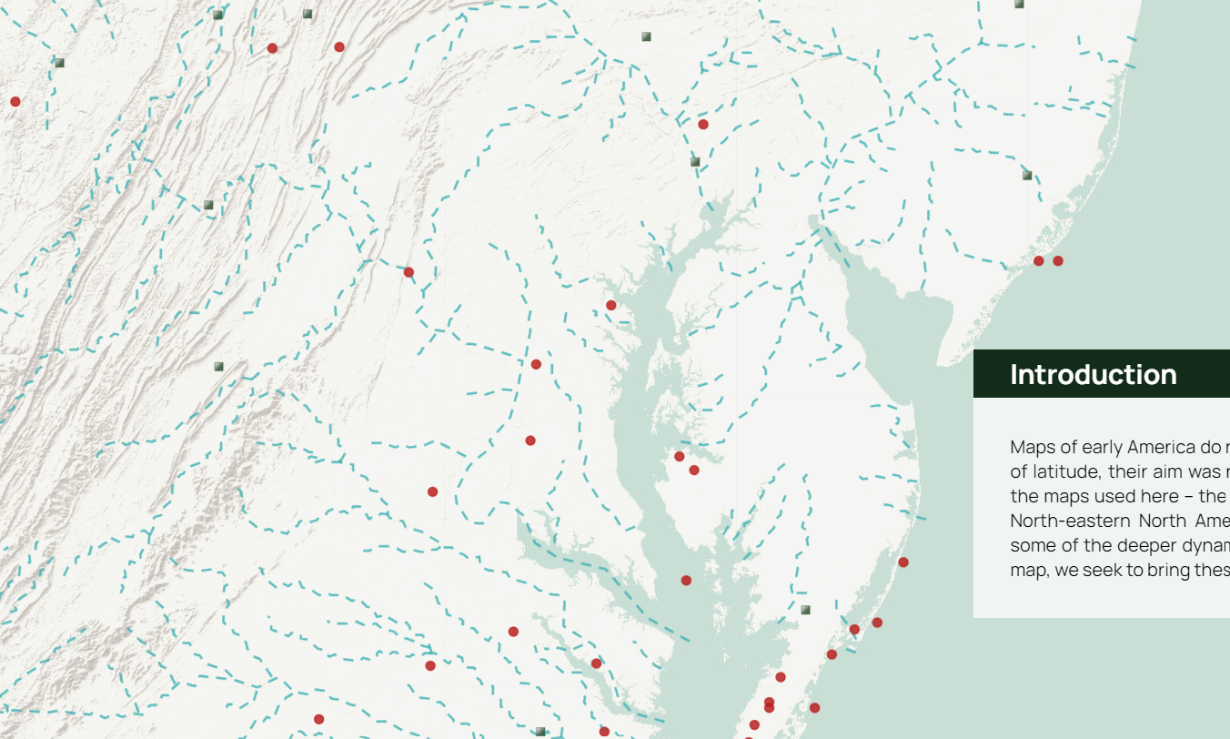
DH and trading zones
‘Accuracy’, ‘staff hours’, ‘what was agreed upon in original brief’, researcher-consultant relationship
PollEv.com​/mw031

Slide 22
DH and trading zones
DH as an opportunity to examine our most basic practices – source analysis and criticism, what is a source, how do we build archives?
Questions around ethics and best (most equitable) ways to do history?
PollEv.com​/mw031

Slide 23
BREAK
Come back at
1030
PollEv.com​/mw031

Slide 24
Digitisation – putting information online
Always good?
Concept of open data, free flow of information as a social good
When might it be a bad idea to have data and information online?
PollEv.com​/mw031

Slide 25
Historians’ ethical responsibilities
Why do you do research?
What is your purpose as a historian?
PollEv.com​/mw031

Slide 26
Historians’ ethical responsibilities
Funding and metrics landscape: what incentives do these create?
Extractivist model of research – where is the knowledge/data coming from?
How is a researcher ‘productive’?
What is legal VS what is ethical
PollEv.com​/mw031

Slide 27
Historians’ ethical responsibilities
Being in a position of understanding the potential ramifications.
Providing informed consent, knowing what options exist.
Professional responsibility, institutional power and knowledge.
‘Nothing about us, without us’
PollEv.com​/mw031

Slide 28
Historians’ ethical responsibilities
So what does an equitable research partnership look like?
Moving away from extraction towards an ethic of care
Reciprocity, co-creation, co-curation, compensation and contribution
What will your research do?
PollEv.com​/mw031

Slide 29
Historians’ ethical responsibilities
Increasing number of voices, participation in curation
Incorporating spontaneity, self-curation and organization
Data structure that reflects community principles of organisation
Thinking about access levels based on needs
Being aware of past academia-community relationships
PollEv.com​/mw031

Slide 30
Today’s class objectives (revisited)
DH and interdisciplinary – theoretical and practical considerations
Research practices and ethics – our obligations
Designing a better historical research project
PollEv.com​/mw031

Slide 31
Next week:
Working with and analysing text – an introduction to Gale Digital Scholarship Lab
Also to learn about the digitization process and where AI is going in this aspect.
Focus Questions:
What can text analysis do for historical research? How is historical expertise and knowledge used in digital text analysis?
PollEv.com​/mw031

Slide 32
Attendance and Leaving Questions (5 mins)
Name, Student number
What was most confusing for you?
What is the most important thing you learnt today?
What is one technique/approach you saw today in class, and how will you adopt/apply this in your own learning?
What skills would you like to learn in the coming weeks?
Anything you would like me to know?
Complete by today, 1300!
PollEv.com​/mw031

